Slide 1
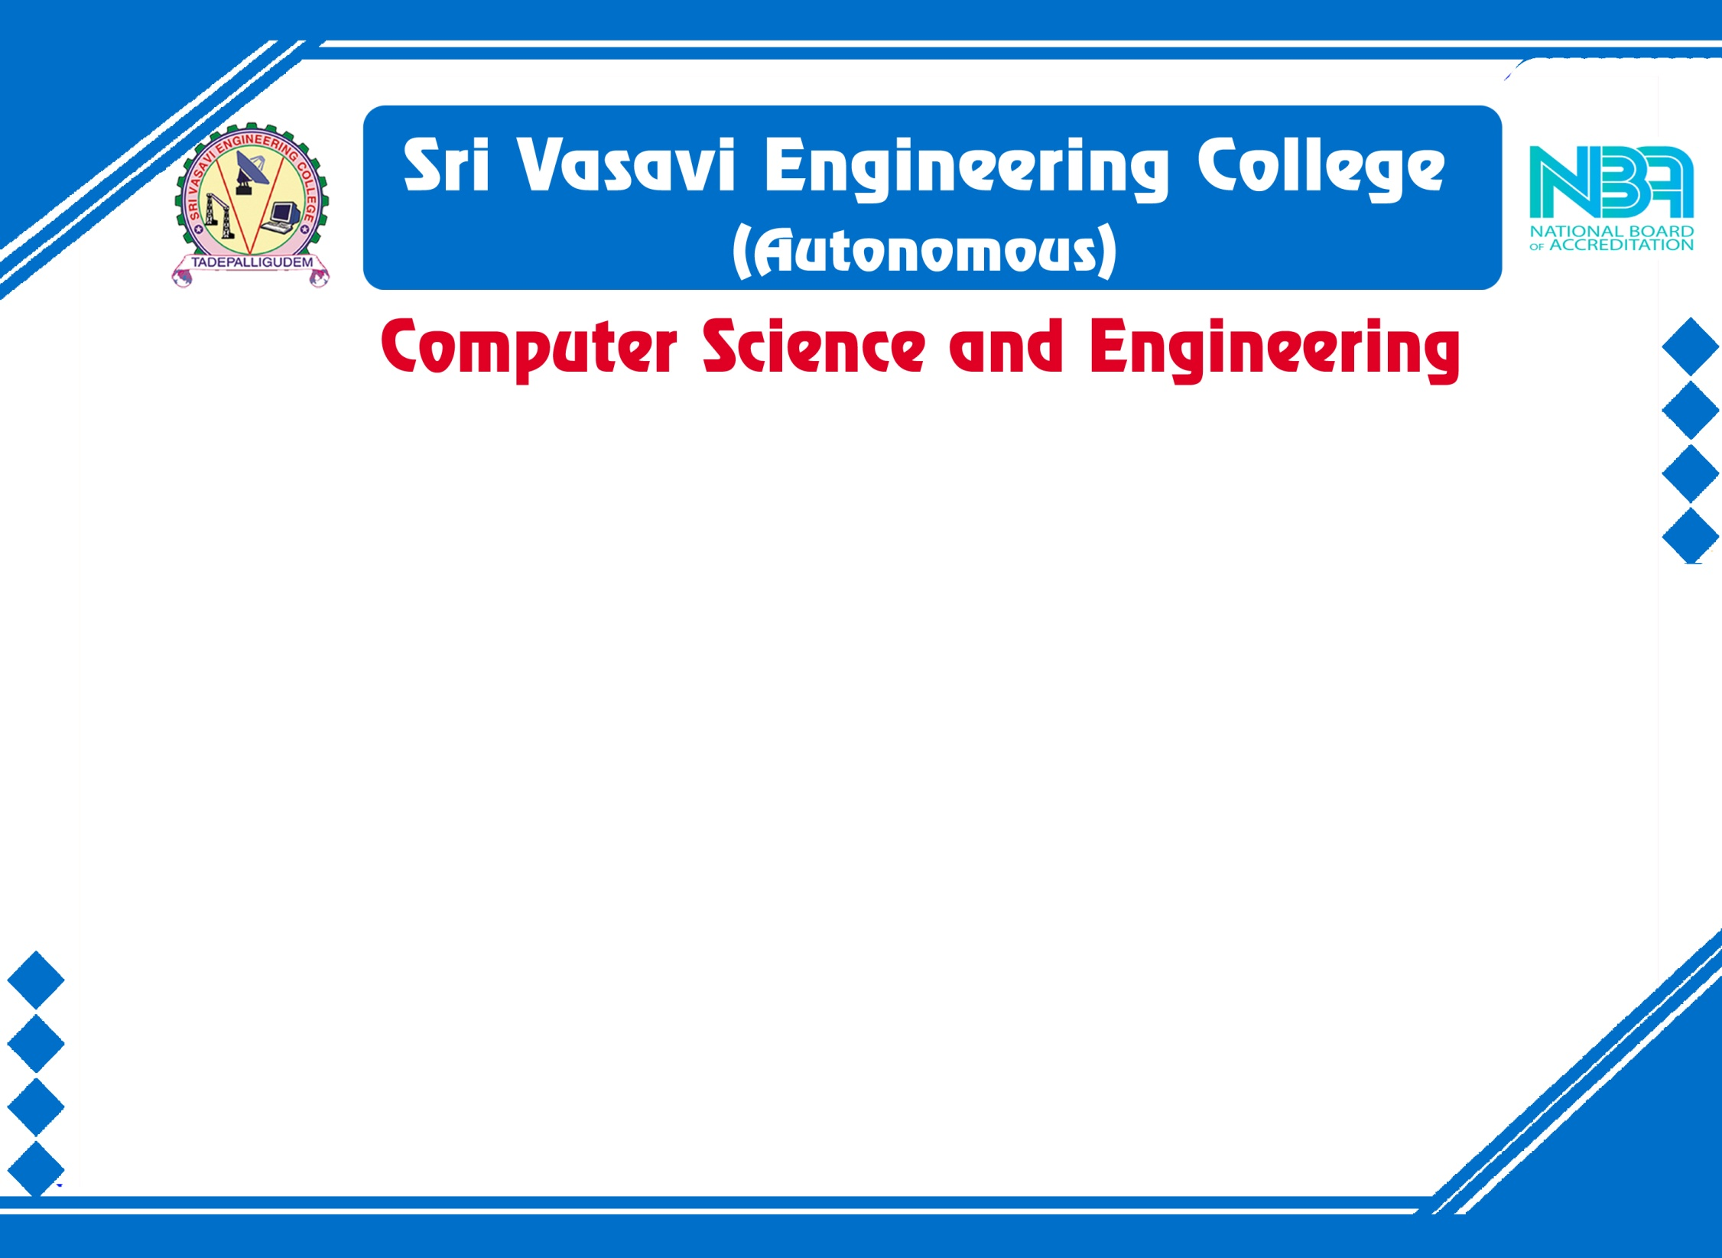

Mini Project Review-1
Batch No: 8
Project Title: SMART CANTEEN MANAGEMENT SYSTEM
S .No | Regd.No | Student Name
1 | 21A81A0657 | P. PRANEETHA
2 | 21A81A0612 | G.S.PRABHU KIRAN
3 | 22A85A0605 | P.VASU
4 | 21A81A0649 | N.CHARLES BUNNY
5 | 21A81A0656 | P.VASANTHA
Project Guide:
Dr.K.SRINIVASA RAO

Slide 2
MINI PROJECT REVIEW I-CONTENTS
Abstract
Introduction
Literature Survey
Problem Statement in Existing System
Proposed System
Objectives
Project domain
Requirement analysis
- Functional Requirements
- Non-Functional Requirements
- Software Requirements
- Hardware Requirements
System Architecture
Methodology
Project Plan

Slide 3
ABSTRACT
The "Smart Canteen Management System" project aims to revolutionize the traditional canteen experience in educational institutions by leveraging modern technologies and automation. This system offers an efficient and convenient approach to managing canteen operations, enabling seamless transactions, improved resource utilization, and enhanced user experience for both faculty members and students. It will bring numerous benefits, including reduced waiting times, increased efficiency, improved inventory management, and enhanced user satisfaction. Every human consumes food 2 – 3 times a day so, in that time it can help them without any delay in their schedule. It offers a scalable and adaptable solution that can be tailored to the specific needs of different educational institutions, paving the way for a modern and technologically advanced canteen experience.
.

Slide 4
INTRODUCTION
In today's fast-paced educational landscape, where time is of the essence, every facet of campus life seeks innovation to enhance efficiency and convenience. The "Smart Canteen Management System" project emerges as a pioneering solution aimed at revolutionizing the conventional canteen experience within educational institutions.
Traditional canteen setups often grapple with challenges such as lengthy queues, manual processes, and inadequate resource management. These limitations not only inconvenience individuals but also hinder the overall productivity of educational institutions. Recognizing these constraints, the "Smart Canteen Management System" endeavors to redefine the way canteens operate, paving the way for a more efficient, tech-driven, and user-centric experience.
.

Slide 5
LITERATURE SURVEY
SNO | Authors | Research Paper | Publication | Title | Conclusion
1 | M. Ambika, Saravana Kumar R, Sandhya S Nair, Ranjith Kumar S | International Journal of Innovative Technology and Exploring Engineering (IJITEE) | Blue Eyes Intelligence Engineering & Sciences Publication | Cashless Canteen System | The advantage of the use of this system is that the scale or size of the business does no longer make any difference to the system. This platform can be enforced on both small and large-scale businesses... Drawback : No liquid cash in payment options.
2 | Suman Chatterjee, Manish Kumar Thakur | International Journal of Engineering Research & Technology (IJERT) ISSN: 2278-0181 | www.ijert.org NCRAEM - 2019 Conference Proceedings | Smart College Management System | This android based project will do the task through the application. It will describes the paper work. The admin, faculty or the student will perform all the task very easily and in more convenience way. Drawback : Only limited to android applications.

Slide 6
Literature Survey
SNO | Authors | Research Paper | Publication | Title | Conclusion
3 | Ketan Bhekare, Chinmay Karandikar, Ganesh Kamble, Varsha Wangikar | Journal of Emerging Technologies and Innovative Research (JETIR) | 2019 JETIR April 2019, Volume 6, Issue 4 | Smart canteen system | More efficient compare to manually work. Due to online process it saves time . The software application will comfort the customers who regularly order food from canteen. Drawback : No timeslot arrangement.
4 | Rupali B. Kale , Ruchika K. Balwade, Vipin B. Gawai | All India Shri Shivaji Memorial Society’s College of Engineering, Pune- 411001, Maharashtra, India | SAMRIDDHI Volume 12, Special Issue 2, 2020 | Online Food Ordering System for College Canteen | The main aim of this paper was to develop an Android app to save the time for those students who are waiting in a long queue for ordering their food also again waiting in another queue to take their delivery. Drawback: This is also limited for android based application and impacts privacy.

Slide 7
Literature Survey
SNO | Authors | Research Paper | Publication | Title | Conclusion
5 | Mr. Ram Krishna Singh , Km. Anjali , Madhavi Tripathi , Ashi Sachan, Antima Gupta | International Journal for Research in Applied Science & Engineering Technology (IJRASET) | Volume 11 Issue V May 2023 | E-Canteen System | The E-Canteen application is designed to help both customer and admin by providing best possible service to the customer and improving sales and attracting more business for admin. Drawback : This also doesn’t provide any time slots for delivery and resulting in waiting queues for delivery again.
6 | Dr. C. Mahiba , Rajashekar , S Dhanush, Santosh Kumar, Sharath Chandra BR5 | International Journal of Research Publication and Reviews | Vol 4, no 6, pp 2276-2279 June 2023 | College E-Canteen Management System | The canteen management team benefits from the elimination of paper usage, negating the need for additional personnel at the billing counter. Drawback : Based on smart billing system in according to the view of seller and there is no feedback giving system.

Slide 8
Problem Statement in Existing System
Canteen management systems have fallen short in addressing the evolving needs of students and faculty members. Long waiting times, manual processes, inefficient resource utilization, and user experiences have become persistent challenges.
While students and faculty members consume food multiple times a day, the existing canteen setups often disrupt their schedules due to cumbersome ordering, payment, and waiting processes. This inconvenience not only impacts individual efficiency but also undermines the overall campus experience.
The lack of scalability and adaptability prevents campuses from tailoring their canteen operations to their unique environments, leading to suboptimal resource allocation and service delivery according to time slots.
In case of large orders prepaid must be included in order to provide security for sellers because in that case refund or taking back orders will be regarded as a huge loss for seller.
.

Slide 9
PROPOSED SYSTEM
The proposed "Smart Canteen Management System" is a comprehensive and innovative solution designed to address the shortcomings of traditional canteen management in educational institutions. By leveraging modern technologies and automation, this system aims to transform the canteen experience into a seamless, efficient, and user-centric process. The core components of the proposed system include:
Digital Ordering and Menu Display
Efficient Order Processing and Payment
Real-time Transaction Tracking
Time Slot Reservation in peak time and Management
Feedback and Ratings System
.

Slide 10
OBJECTIVES
1. Streamline Operations: Enhance canteen efficiency by digitalizing ordering, reducing waiting times, and optimizing resource allocation.
2. Personalized Experience: Provide users with tailored menus, real-time updates, and personalized recommendations for a satisfying dining journey.
3. Data-Driven Insights: Generate reports on sales trends and user preferences to inform strategic decisions and continuous improvement.
4. Scalable Solution: Develop an adaptable system that can be customized to suit the specific requirements of diverse educational institutions.
5. Technological Advancement: Leverage modern technologies to create a seamless, secure, and user-centric canteen environment.
.

Slide 11
Project Domain
Food Services and Hospitality Management using Django Python Framework.

Slide 12
Requirement analysis
Technologies used in this project are:
Front-End : HTML, CSS
Back-End :Django using python
Database :PostgreSQL
Software requirements:
Local Server: XAMPP
Database : PostgreSQL
Language : PHP
Text Editor : Sublime/ VS Code
Hardware requirements (Minimum):
Processor : Intel Celeron or higher
RAM : 4GB or higher
OS : Windows 7 or higher

Slide 13
Functional requirements
1)Registration and login
Enable a new user to register to the system.
Authenticate and allow user to login on the web app(through institutional details).
2)Menu and Ordering System
Enable the customers to go through menu and place the order.
Enable him/her to edit his choices before proceeding to place the order.
3) Payment System
Display the payment bill to the customer.
Enable the customer to pay for the placed order through Google Pay or Paytm …(using QR codes). and also enable the system to notify the admin of the successful transaction.
4) Feedback System
Enable a user to submit a Feedback on the CMS , which contains detailed explanation to his/her problem if any just like feedback.

Slide 14
Non functional requirements
The website shall accommodate 150-200 users during the peak usage time.
Session duration must be of 5 minutes.
Order details must be sent to the customer with in 3 minutes after confirmation.
The system shall display confirmation messages to users within 10seconds after the user submits information to the system.
Responses to queries shall take no longer than 30 seconds to load onto the screen after the user submits the query.

Slide 15
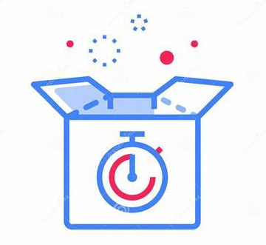

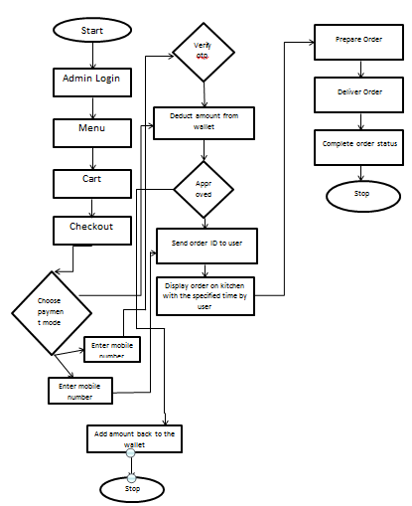





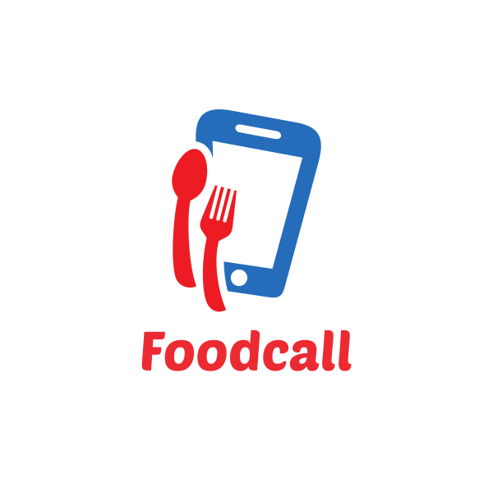


System Architecture
Rating and feedback
Time slot for delivery in peak time
Enrollment of student/staff or any guests
Canteen Management system
Bill generation
Refer menu
Receives an authentication SMS
Purchase meals and other foods
Payment options

Slide 16
Methodology
For a "Smart Canteen Management System" project, an Agile methodology, specifically Scrum, is likely a suitable choice.
Agile Scrum Methodology:
Overview: Scrum is an Agile framework that emphasizes iterative development, collaboration, and flexibility. It breaks the project into smaller time-bound iterations called "sprints," typically lasting 2 to 6 weeks, during which a set of features is developed and delivered.
BENEFITS:
Iterative Development , Quick Deliveries , Adaptation
Algorithm used for time slot management:
Time-Based Priority Queue Algorithm: This algorithm maintains a queue of elements with associated priorities, where priorities can change over time.
Indexed Priority Queue: Maintain an index for each element in the queue, allowing quick updates of priorities.
Adaptive Priority Queue: Adjust priorities dynamically based on the elapsed time or other conditions.

Slide 17
Project plan
Initiation
Technology Selection
Database Design
Project
discussion
System Design
Developing frontend
Project Plan
Requirement gathering
Integrate and test
Deployment
And project closure

Slide 18

TEAM -08

